Slide 1
INTRODUCTION
NAME: VIVIAN KERUBO MOSOMI
Email: kerubomosmi7@gmail.com
Country: Kenya
College: Jomo Kenyatta University of Agriculture and Technology (JKUAT)
Specialization: Data Science

Slide 2
Problem Description
ABC Bank wants to predict whether a particular customer will buy their term deposit product based on their past interactions with the bank or other financial institutions. This will allow the bank to focus its marketing efforts on customers who are more likely to purchase the product.
GitHub Repository Link
https://github.com/Vee2002/DataGlacier_Internship/tree/vc/Data%20Glacier

Slide 3
Dataset Overview
Total Number of Observations - 41188
Total Number of Files - 1
Total Number of Features - 21
Base Format of the File - CSV File
Size of the Data - 5.699 MB
These are the categorical columns and what they represent:
Job - Represents the job type of the customer which can be blue collar,technician,services,management,entrepreneur,self employed,housemaid,student etc
Marital - Status of the customer which can be married, single, divorced or unknown
Education - Level of education of the customer.That is: University degree,HighSchool,Professional Course etc
Default - Whether the customer has a credit default or not.Can also be unknown
Housing - If the customer has a housing loan or not.
Loan - Whether the customer has a personal loan.
Contact - Type of communication used to contact the customer i.e - Cellular,Telephone
Month - Last contact month of the year
day_of_week - Day of the week when the customer when last contacted
poutcome - Outcome of the previous marketing campaign.It can be failure,success or nonexistent
y(Has yes or no values which represent whethere the customer will purchase the term deposit or not)

Slide 4
Dataset Overview
These are the numerical columns and what they represent:¶
Age - Age of the customer
Duration - Duration of the last contact with the customer in seconds
Campaign - Number of contacts performed during the campaign for the customer
pdays - Number of days since the customer was last contacted in the previous campaign
previous - Number of previous marketing campaigns in which the customer was contacted before the current campaign.Eg - 4561 customers were contacted during the first previous campaign and so on.
emp.var.rate - Represents the employee variation rate. Whether the employment rate decreased or increased by the indicated percentage.A positive value indicates an increase in employment levels while negative values indicate a decrease in employment levels.
cons.price.idx - Consumer Price Index.It's a measure of inflation where higher values indicate inflaction and lower values indicate deflation.
cons.conf.idx - Consumer Confidence Index.Measures consumer's confidence about the state of the economy.Values closer to zero inidcate optimism in their financial situation and the economy's future.Values further from zero indicate pessimism in their financial institution
euribor3m - Euribor 3-month rate.It represents the average interest rate at which European banks lend unsecured funds to one another for a three-month period.Higher values indicate higher short-term borrowing costs in the Eurozone hence higher market demand for funds and vice versa.
nr.employed - Number of employees

Slide 5
DATA CLEANING

Slide 6

I took these steps for data cleaning:
Renaming columns
Checking for outliers
Checking for null values and duplicates
Confirming if values of columns are in the correct format

Slide 7
EXPLORATORY DATA ANALYSIS

Slide 8
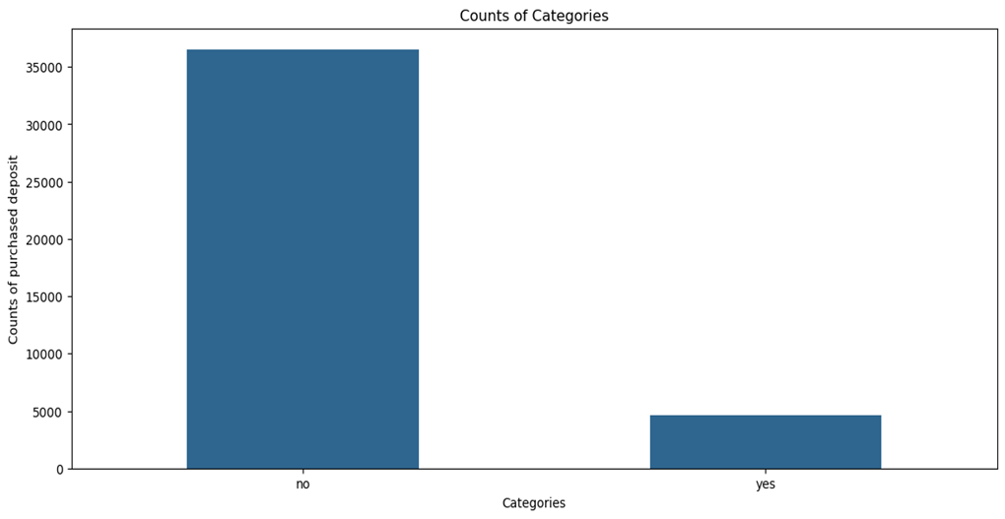
i) Purchased Deposit Counts
Most people did not purchase the term deposit

Slide 9
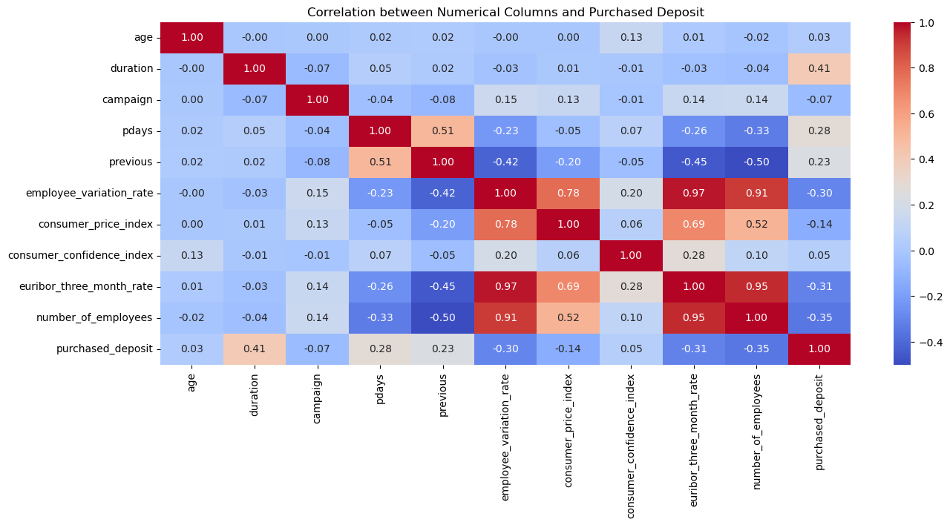
i) Correlation Plot
According to the plot, the number of employees is on the rise from March to August

Slide 10
Observations from the correlation plot
Duration is moderately positively correlated to purchased deposit. It has a positive correlation of 0.41
Pdays and previous are weakly positively related to purchased deposits. With a correlation of 0.28 and 0.23 respectively.
Age has a very weak positive correlation of 0.03 to purchased deposit.
The following columns are negatively correlated to purchased deposit:
campaign, employee_variation_rate, consumer_price_index, euribor_three_month_rate, number_of_employees.

Slide 11
DATA PREPROCESSING

Slide 12

I performed the following data preprocessing steps on the data:
One Hot Encoding
Cyclic Encoding
Dropping columns that are less efficient in our dataset.They have no effect on the target variable
Normalization of the data
Splitting the dataset to train and test
Solving class imbalance

Slide 13
MODELLING

Slide 14
I have used the following models in my project:
1.Logistic Regression(BaseLine Model)
2.Random Forest(Ensemble Model)
3.XGBoost(Boosting Model)
The following table shows the comparative performance:
Model | Accuracy(%) | Precision(%) | Recall(%) | F1-Score(%)
Logistic Regression | 90.36 | 65.50 | 38.52 | 48.51
Random Forest | 90.51 | 62.42 | 48.92 | 54.85
XGBoost | 91.27 | 66.45 | 52.42 | 58.61
XGBoost(After Tuning) | 91.54 | 68.87 | 51.49 | 58.93

Slide 15
EVALUATION

Slide 16
I have used F1-Score as my Evaluation Metric for the following reasons
Accuracy - Measures overall accuracy
Precision - When False Positives matter the most
Recall - When False Negatives are more important
F1-Score - Best used when both precision and recall are important
For my project, Precision(False positives) means predicting that the customer will purchase the term deposit and they do not.This leads to waste of marketing resources which we do not want to be the case.
While Recall(False Negatives) means predicting that the customer will not purchase the term deposit and they actually do,leading to missed opportunity for revenue which we also do not want to be the case.
I used F1-Score to cater for both situations.

Slide 17
4.RECOMMENDATIONS

Slide 18
1.Develop marketing campaigns that highlight the benefits of term deposits, such as security, returns, and suitability for long-term goals by promotions or incentives eg slightly higher interests for higher customers. The bank can consider holding webinars and workshops to educate customers on the importance of term deposits.
2.Increase the reach and frequency of marketing campaigns, particularly focusing on customers who were not contacted previously. By considering using cellular to contact customers as it is yielding more results compared to telephone.
3.Focus marketing efforts during periods of high consumer confidence or low inflation (e.g., early in the year or after mid-year). The bank can monitor economic indicators like the Consumer Confidence Index and Euribor rates to plan campaigns strategically.
4.Train agents to have meaningful, informative conversations that address customer concerns within the call duration 0-500 seconds as most calls are within that range. They can provide training to call agents on how to effectively pitch term deposits.

